Slide 1

Group 8
Member:
Ngo Hoan Tam Huy - CE140548
Ngo Nguyen Hong Hai Long - CE140007
Tran Hoang Qui – CE140632
Tran Ngoc Man Huy - CE140289
Mentor:
Mr. Vo Hong Khanh

Slide 2
Table of Contents
01
02
03
04
04
Topic
Use case
Side map
Theme
Demo

Slide 3
01
Topic

Slide 4
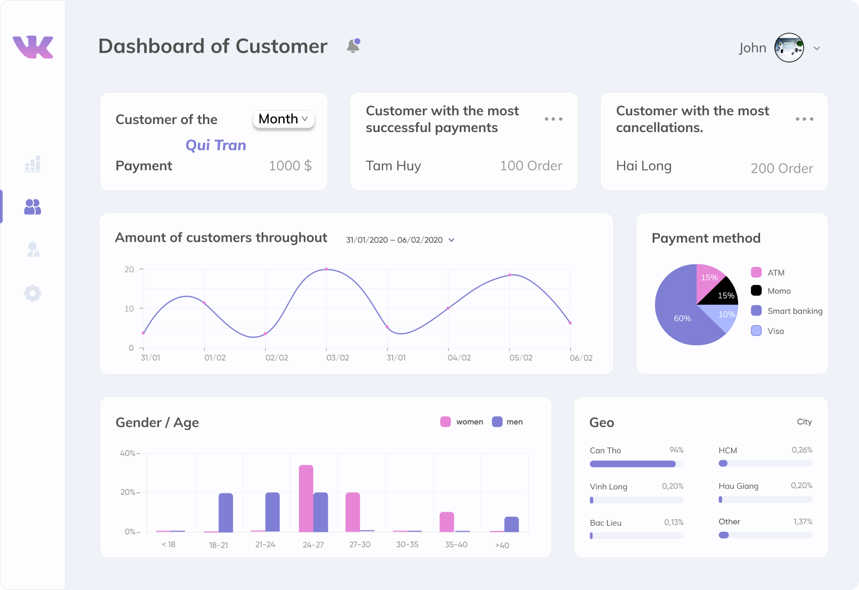
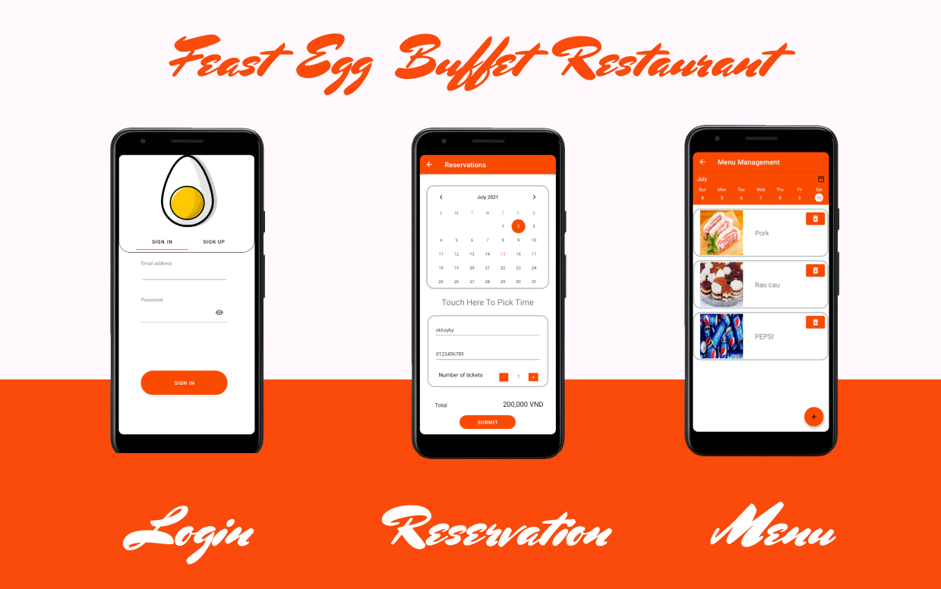
1 Topic
Feast Egg Buffet Restaurant app
Feast Egg Buffet Restaurant mobile application that help users booking table for their meals .
Feast Egg web app help managing restaurant activities
Feast Egg Managing Tools

Slide 5
02
Use case

Slide 6
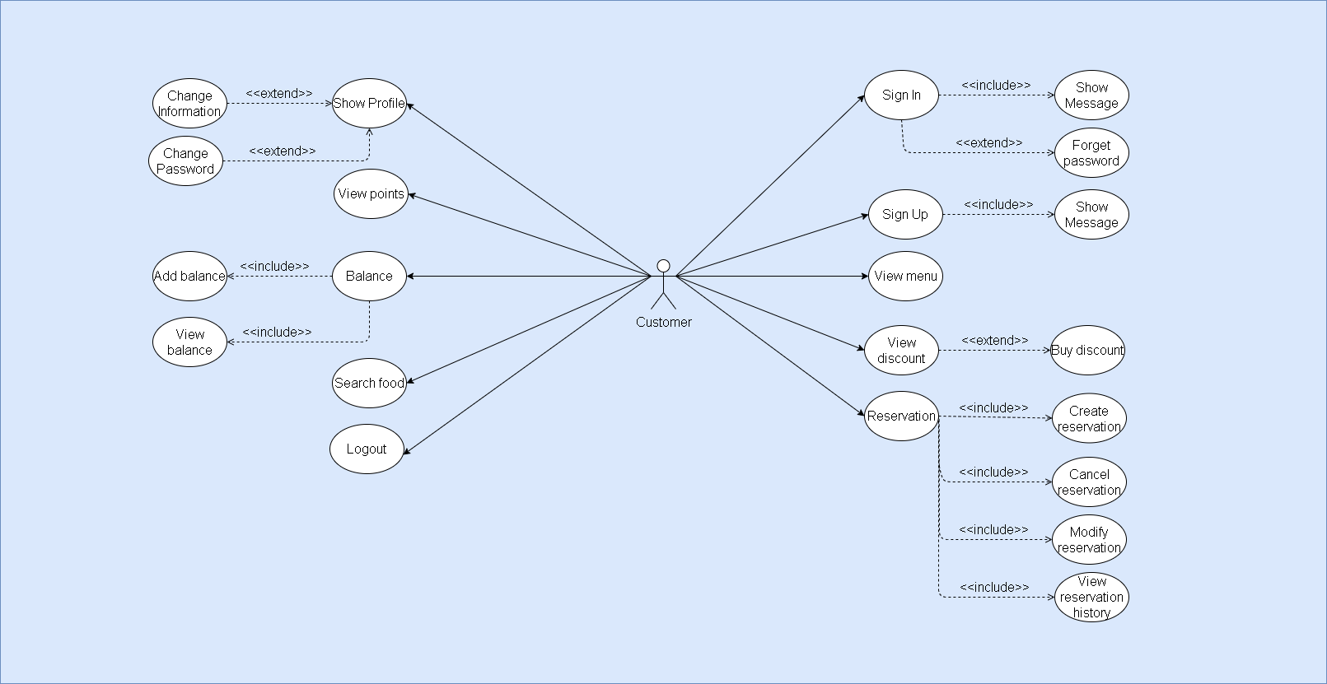
2.1 Customer
Customer use case

Slide 7
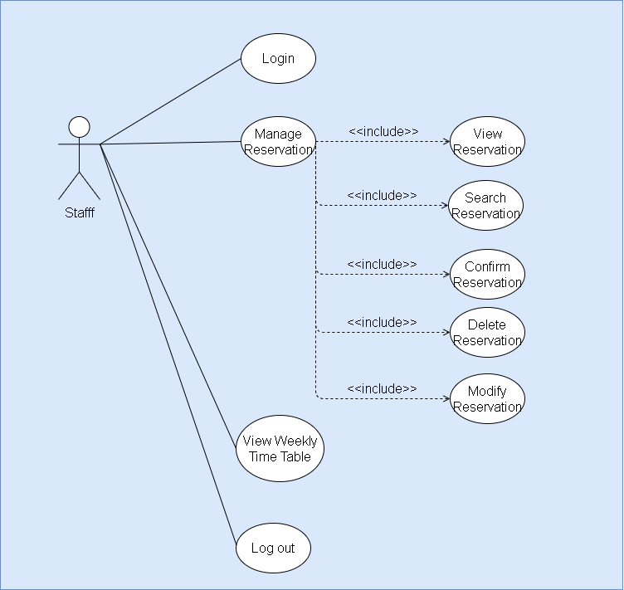
2.2 Staff
Staff use case

Slide 8
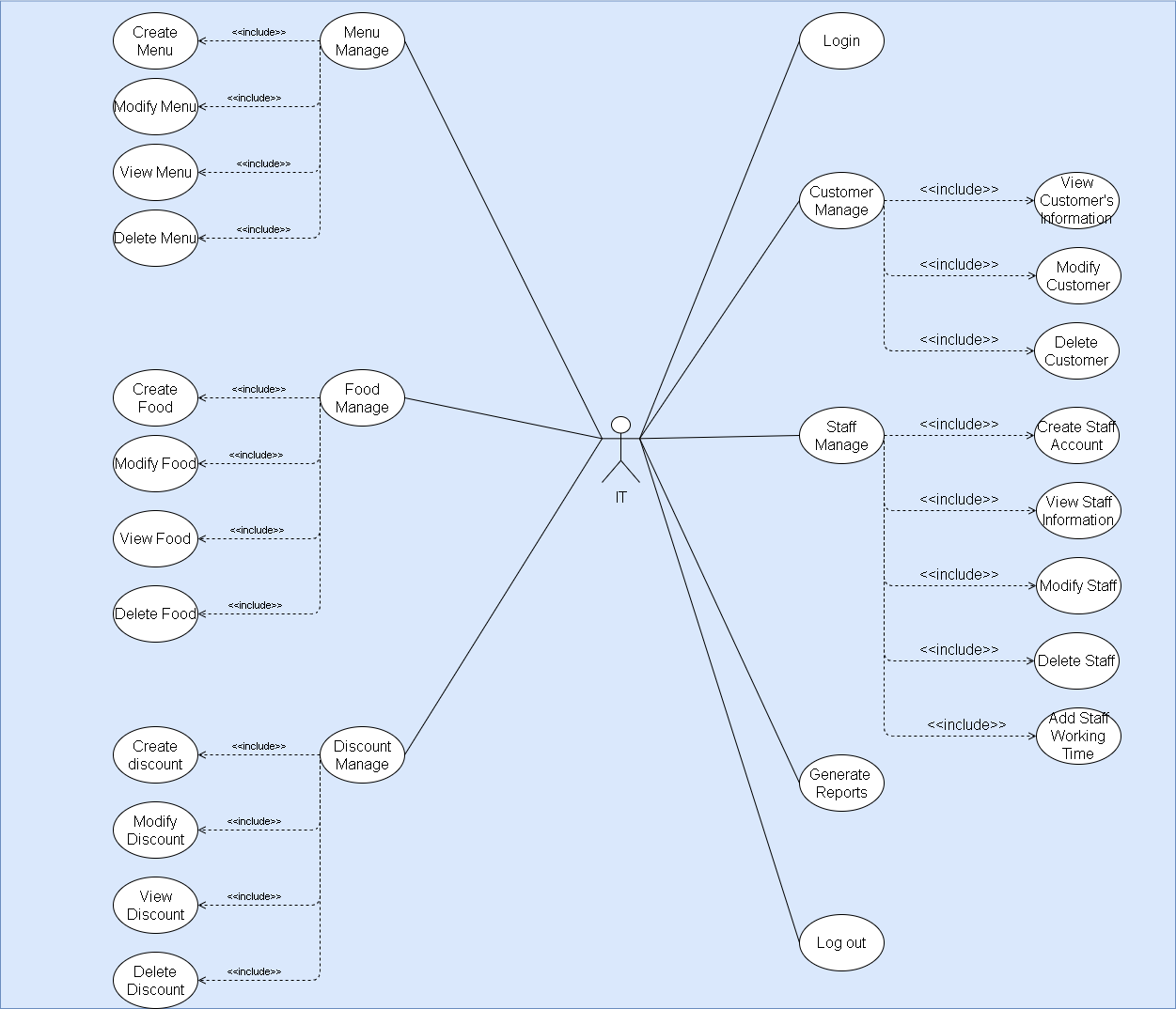
2.3 IT
IT use case

Slide 9
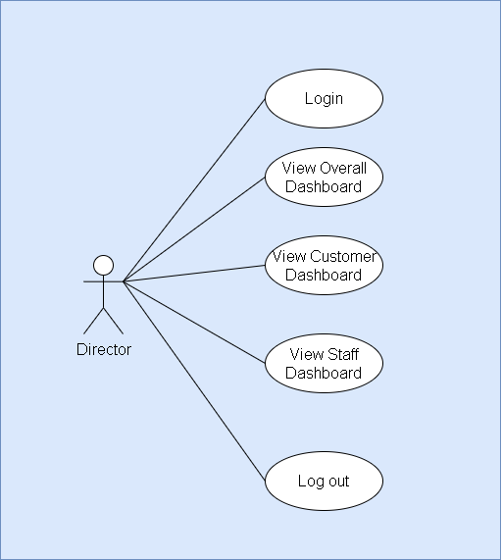
2.4 Director
Director use case

Slide 10
03
Side Map

Slide 11
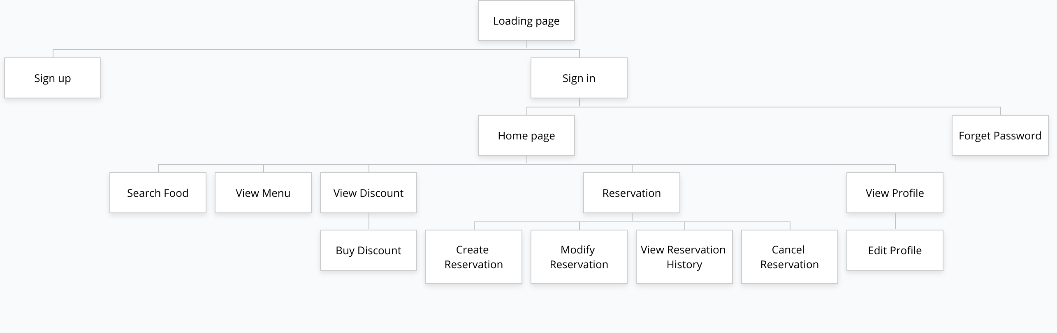
3.1 Customer side map
Customer side map

Slide 12
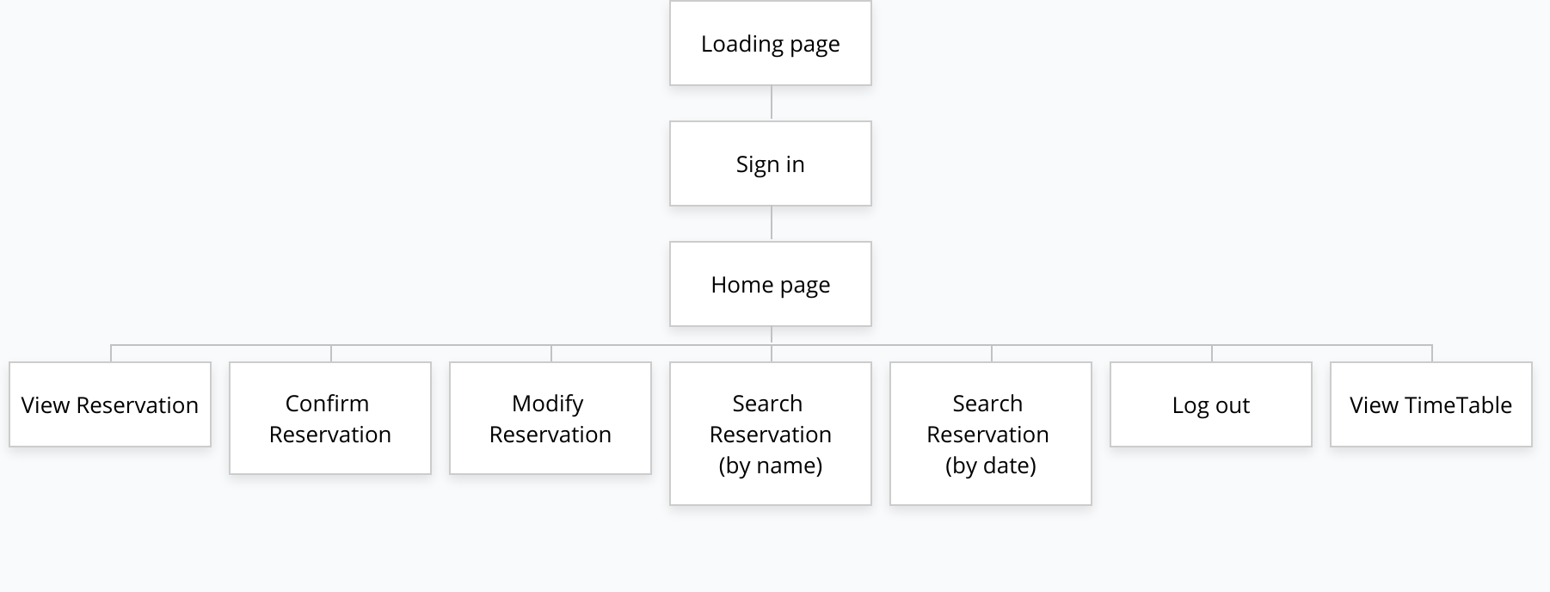
3.2 Staff side map
Staff side map

Slide 13
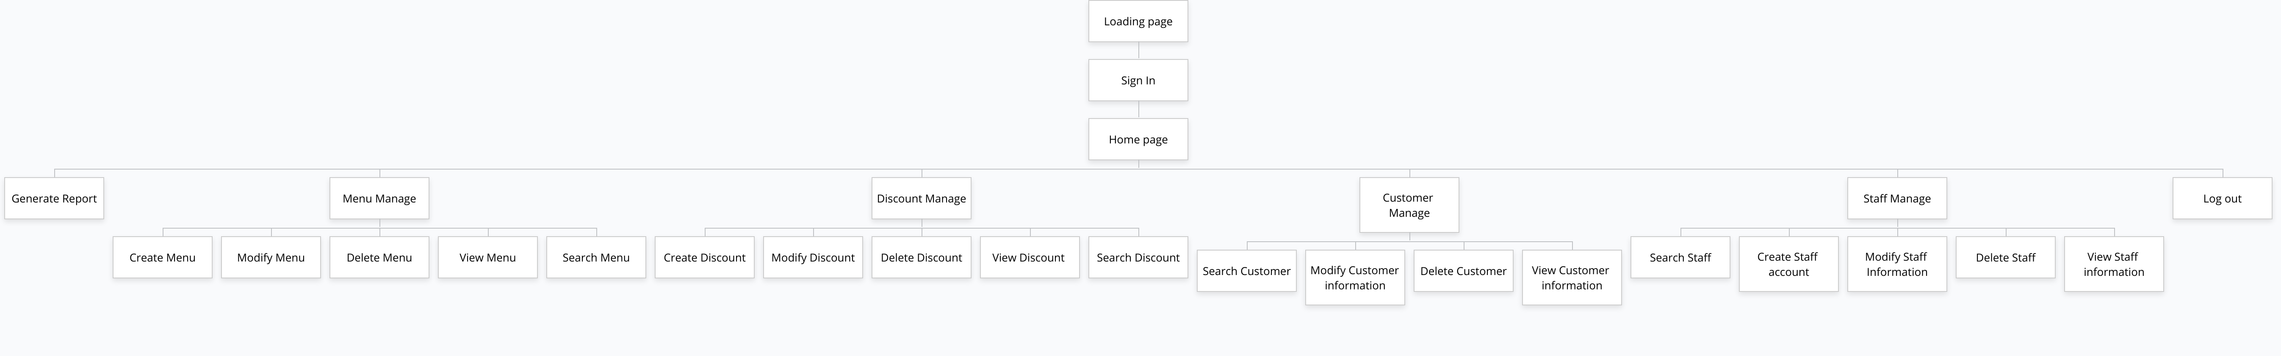
3.3 IT side map
IT side map

Slide 14
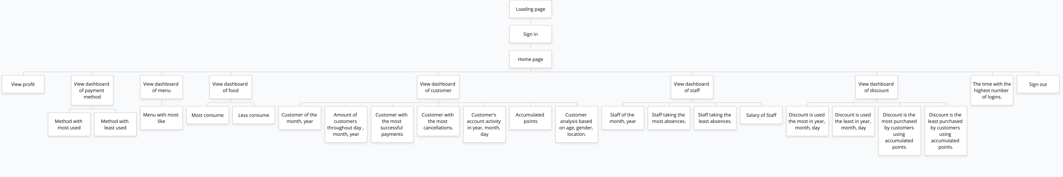
3.4 Director side map
Director side map

Slide 15
04
Theme

Slide 16
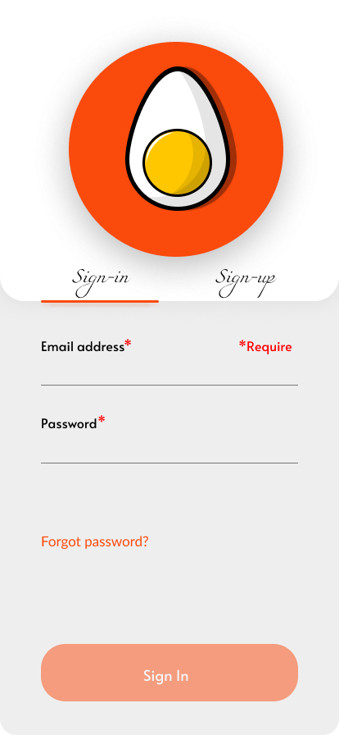
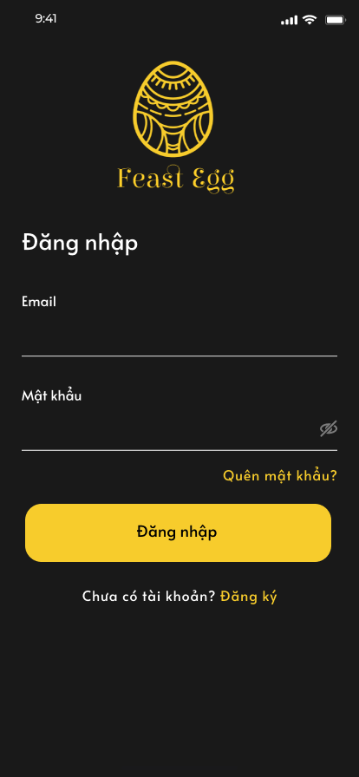
4.1 Customer theme
Theme 1
Theme 2

Slide 17
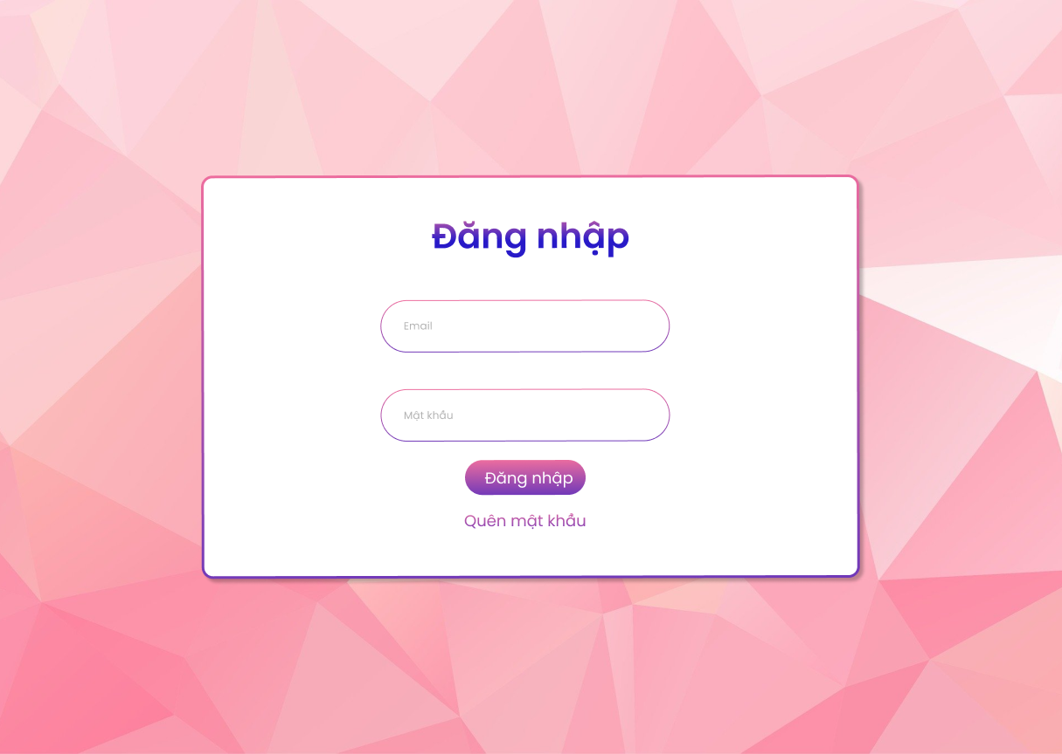
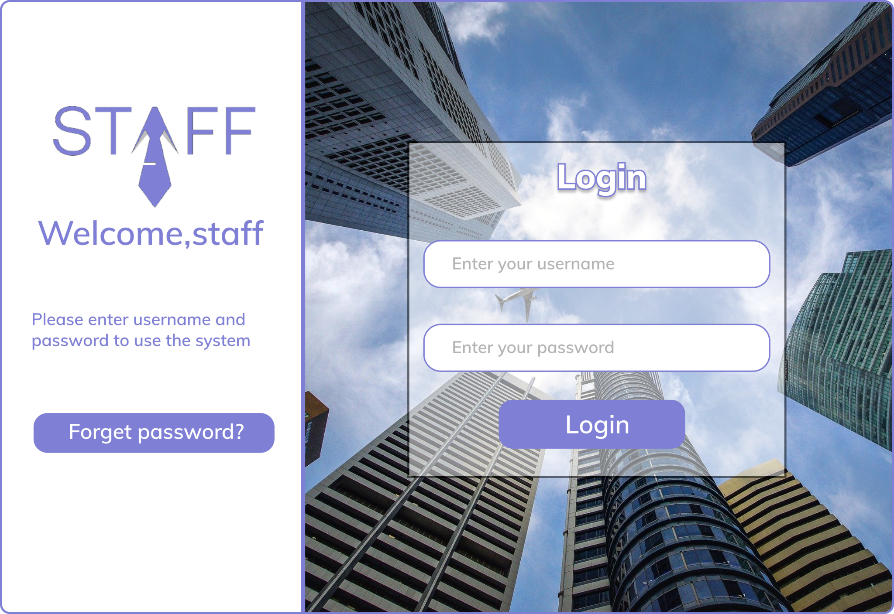
4.2 Staff theme
Theme 1
Theme 2

Slide 18
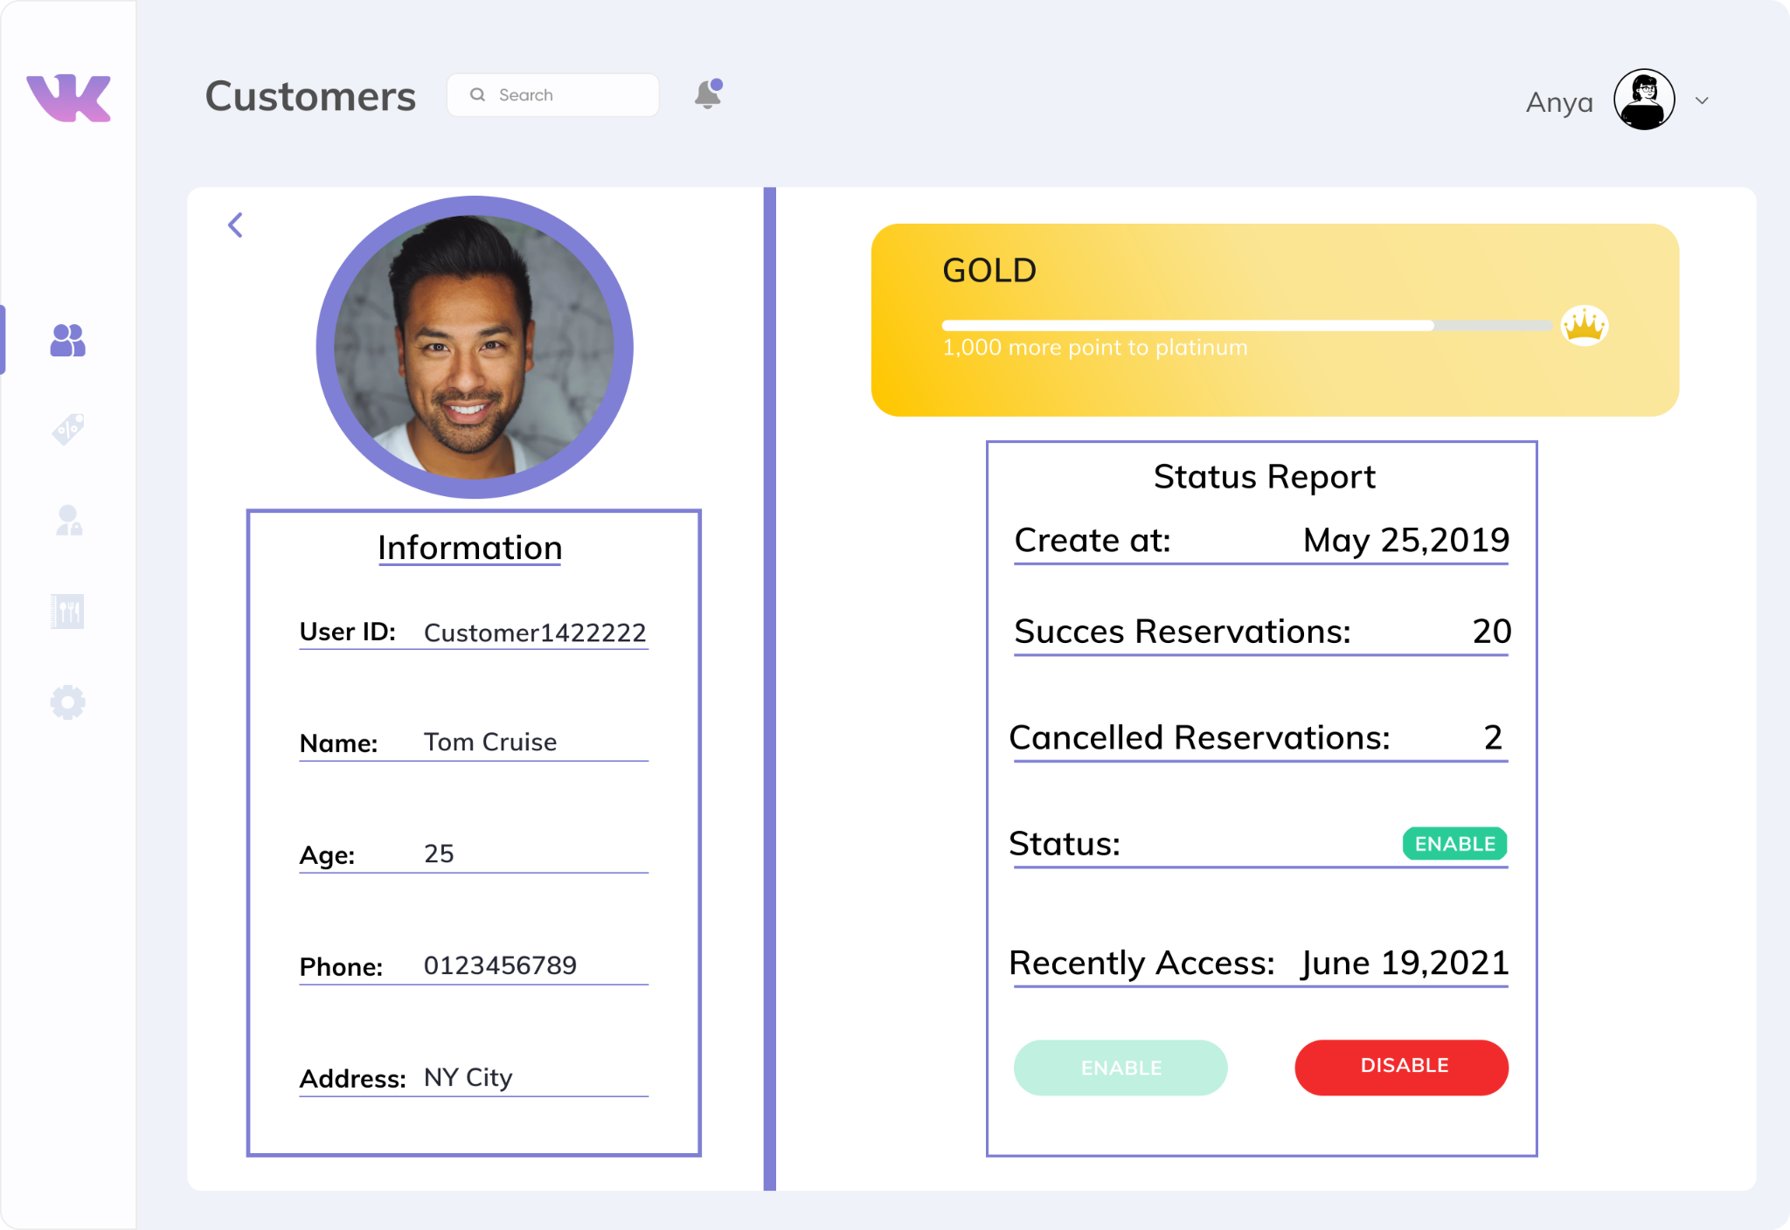
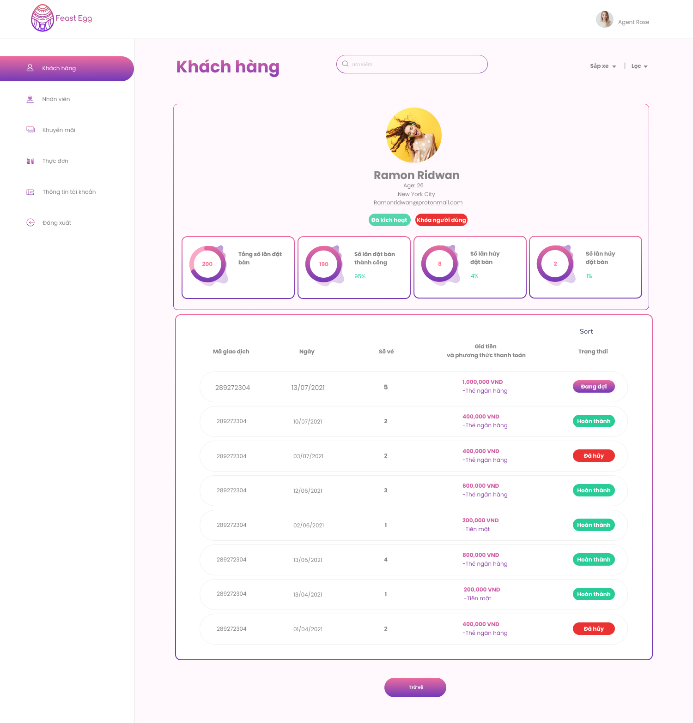
4.3 IT theme
Theme 1
Theme 2

Slide 19
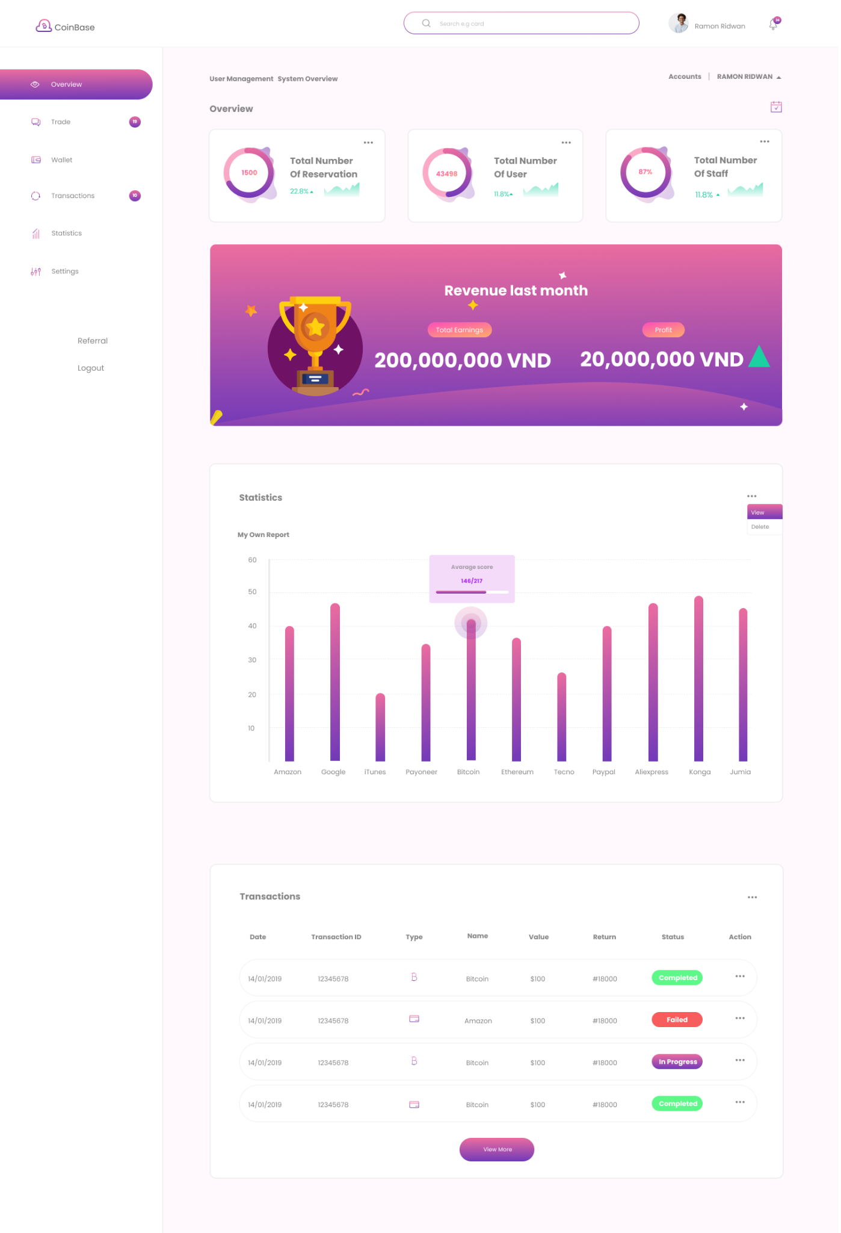
4.4 Director theme
Theme 1
Theme 2

Slide 20
05
Demo

Slide 21
Q&A

Slide 22
Thanks!

